Slide 1










Consumer Goods
Queries & Insights
SQL, Power BI, Power Point
Mythily Ramanathan

Slide 2
Why?
Problem Statement / Task
What?
About the company
How?
Data, request and tools

Slide 3
Why?
Problem Statement:
Atliq Hardwares (a fictional company) is a prominent computer hardware manufacturer with a global presence.
The need : Enhanced data insights to facilitate swift and informed decision-making.
Adding a data analytics team and hiring new analysts.
Seeking individuals proficient in both technical and soft skills.
To assess these competencies, initiated a SQL challenge as part of the hiring process, aiming to gain a comprehensive understanding of candidates' capabilities."

Slide 4
Task :
1. There are 10 ad hoc requests for which the business needs insights. 2. Write SQL query to answer these requests.
3. Visualize the output and give insights. 4. Create a presentation for the top-level management who are target audience.

Slide 5
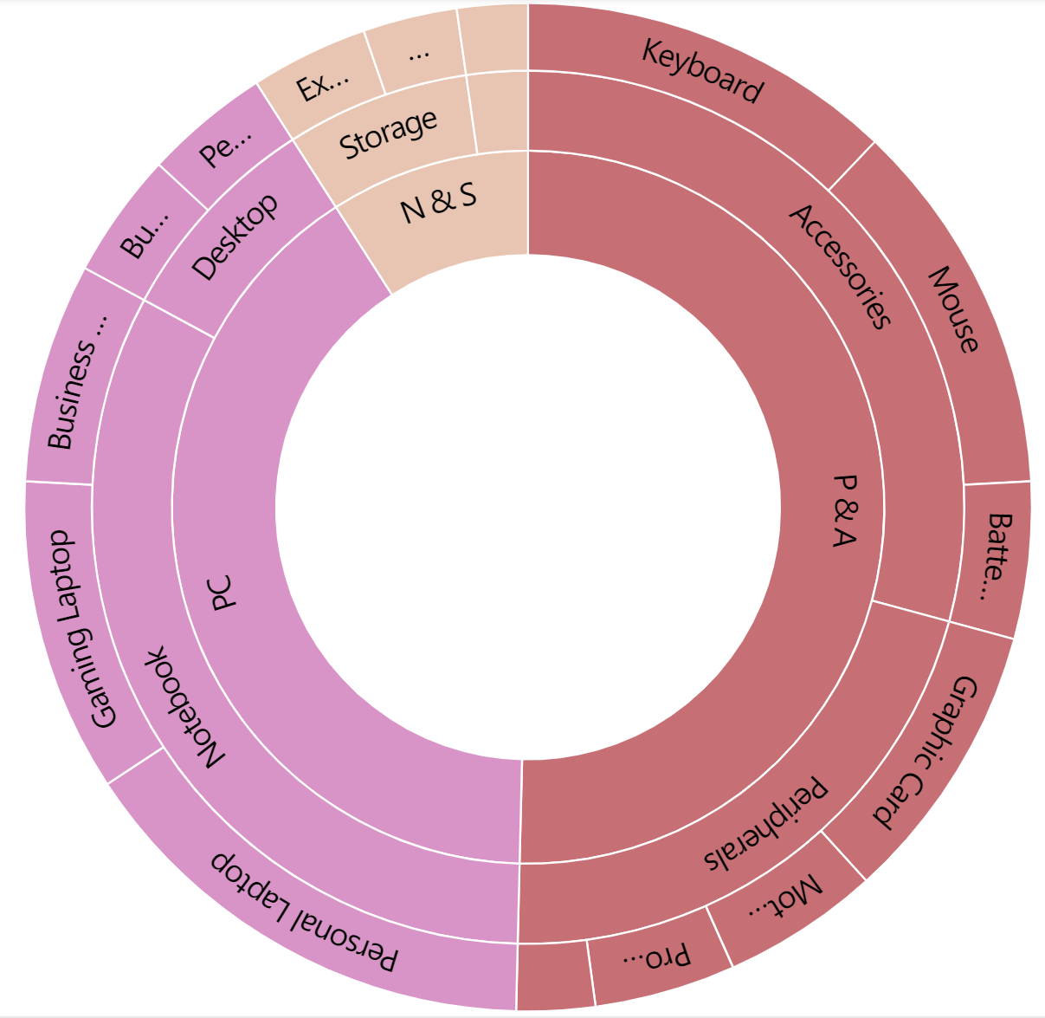
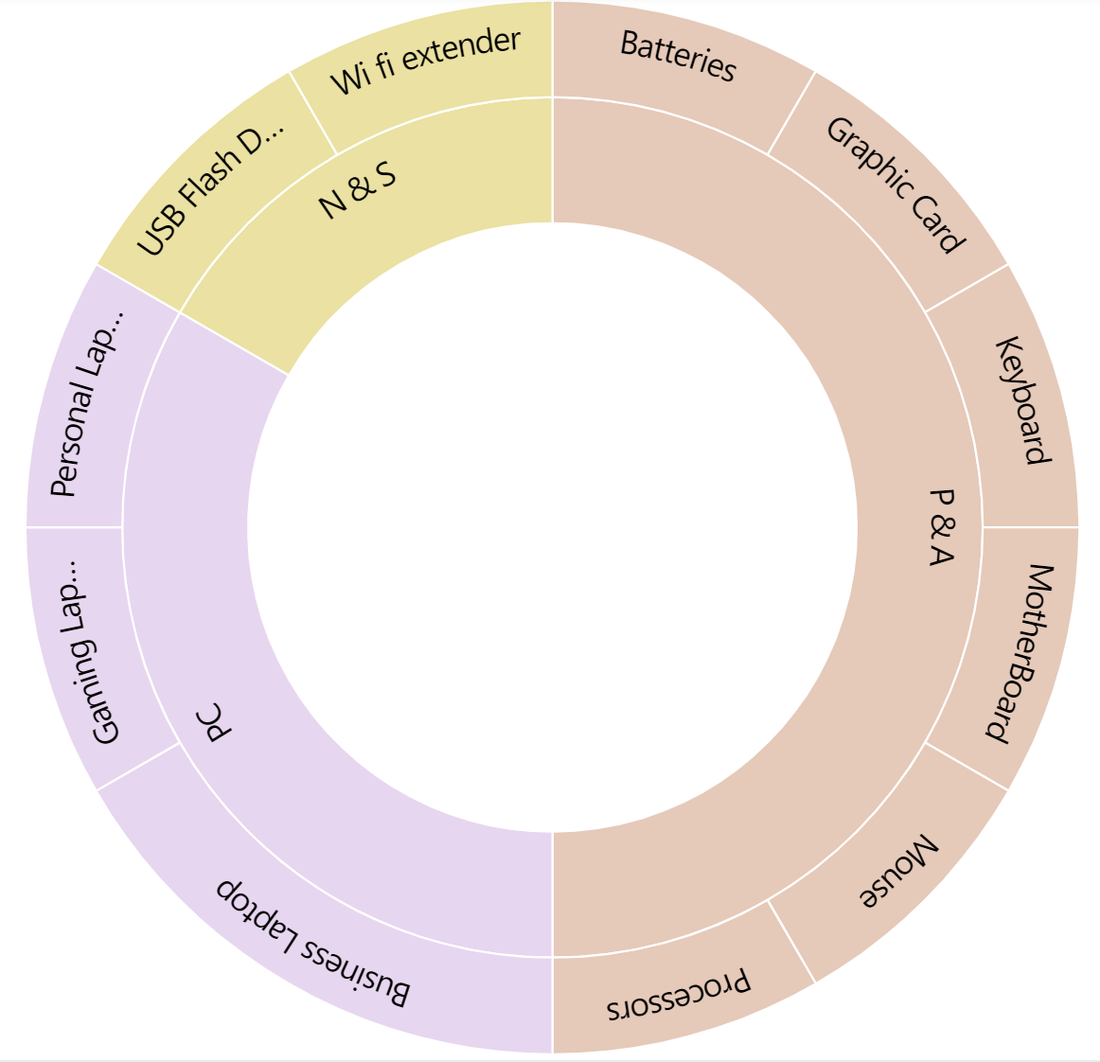
Atliq Hardwares
What?
Products
Outer Circle:
Category
Middle Circle:
Segment
Inner Circle:
Division
Fiscal Year
FY2020 = September 2019 - August 2020
FY2021 = September 2020 - August 2021

Slide 6
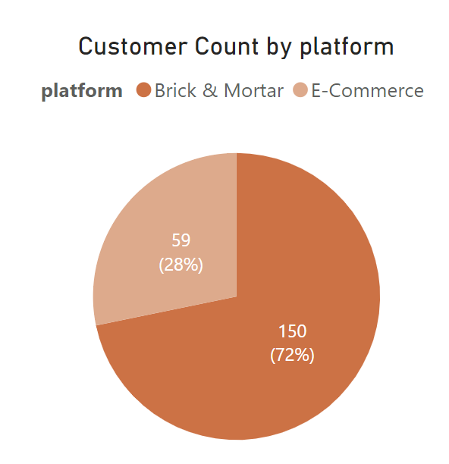
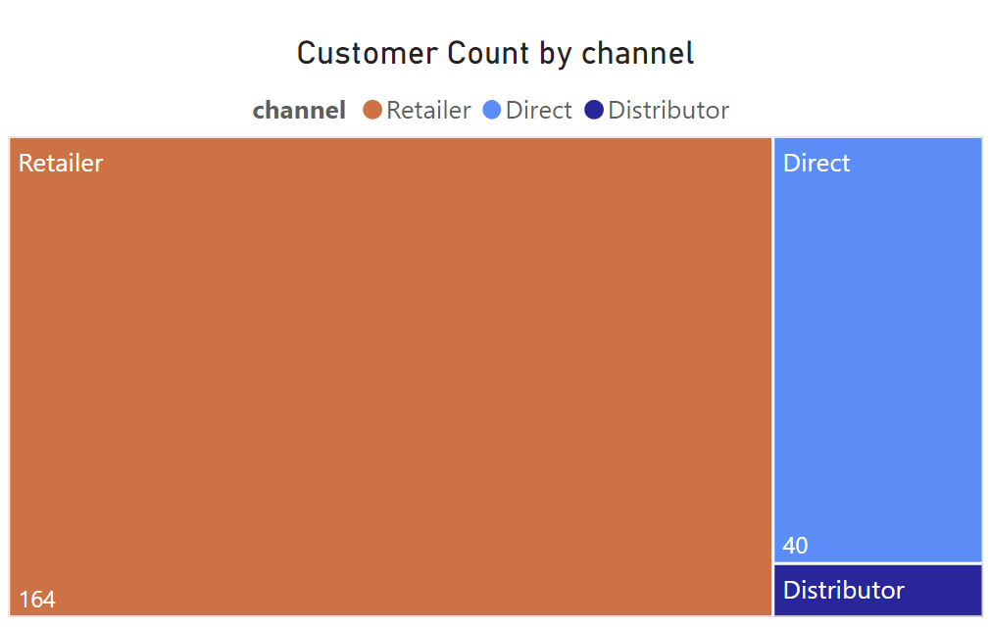
Customers

Slide 7
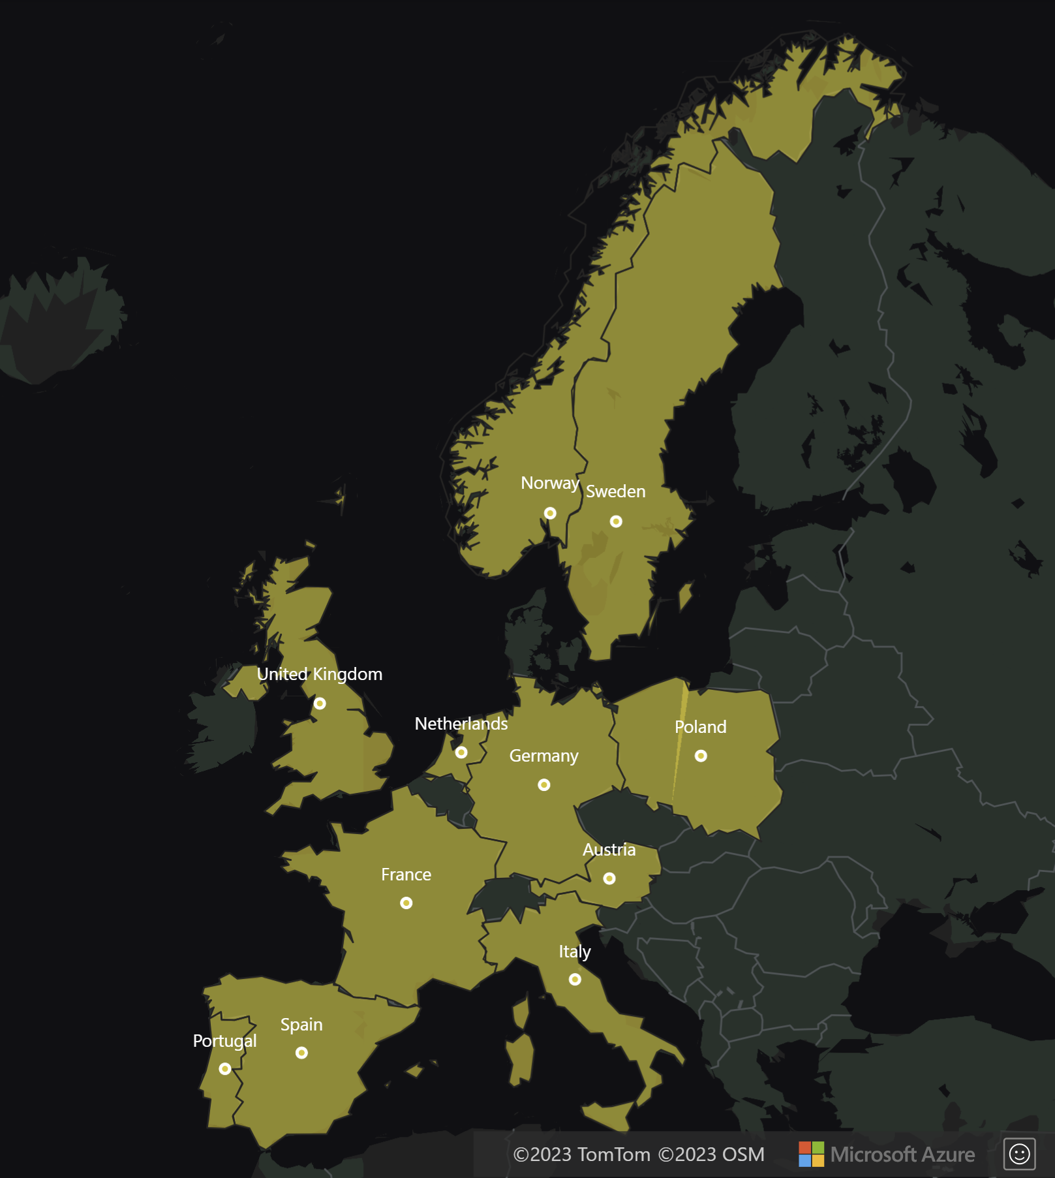
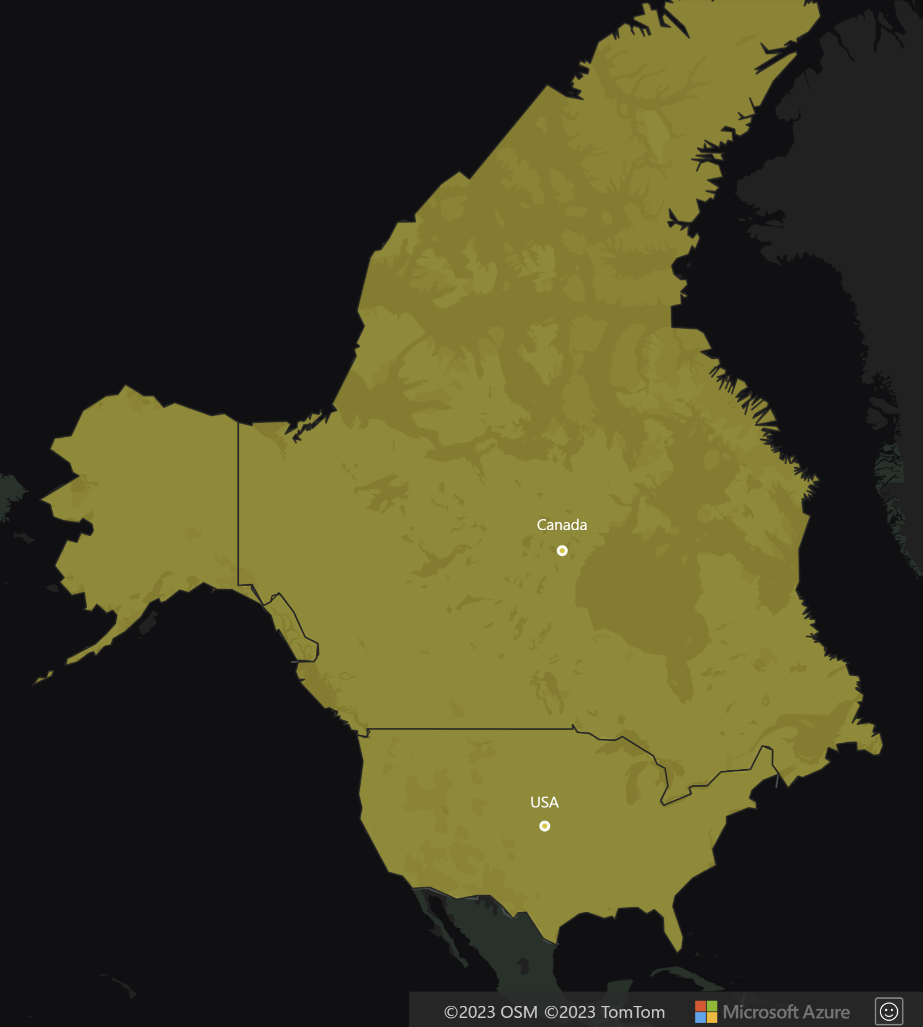
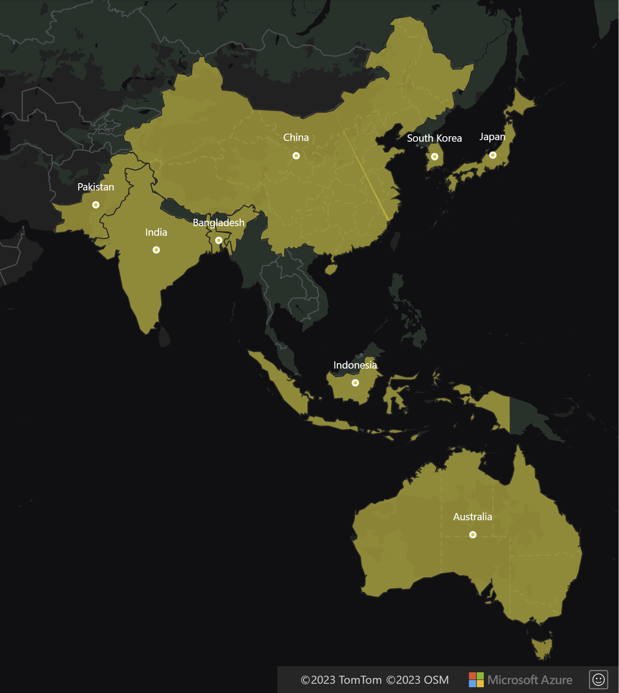
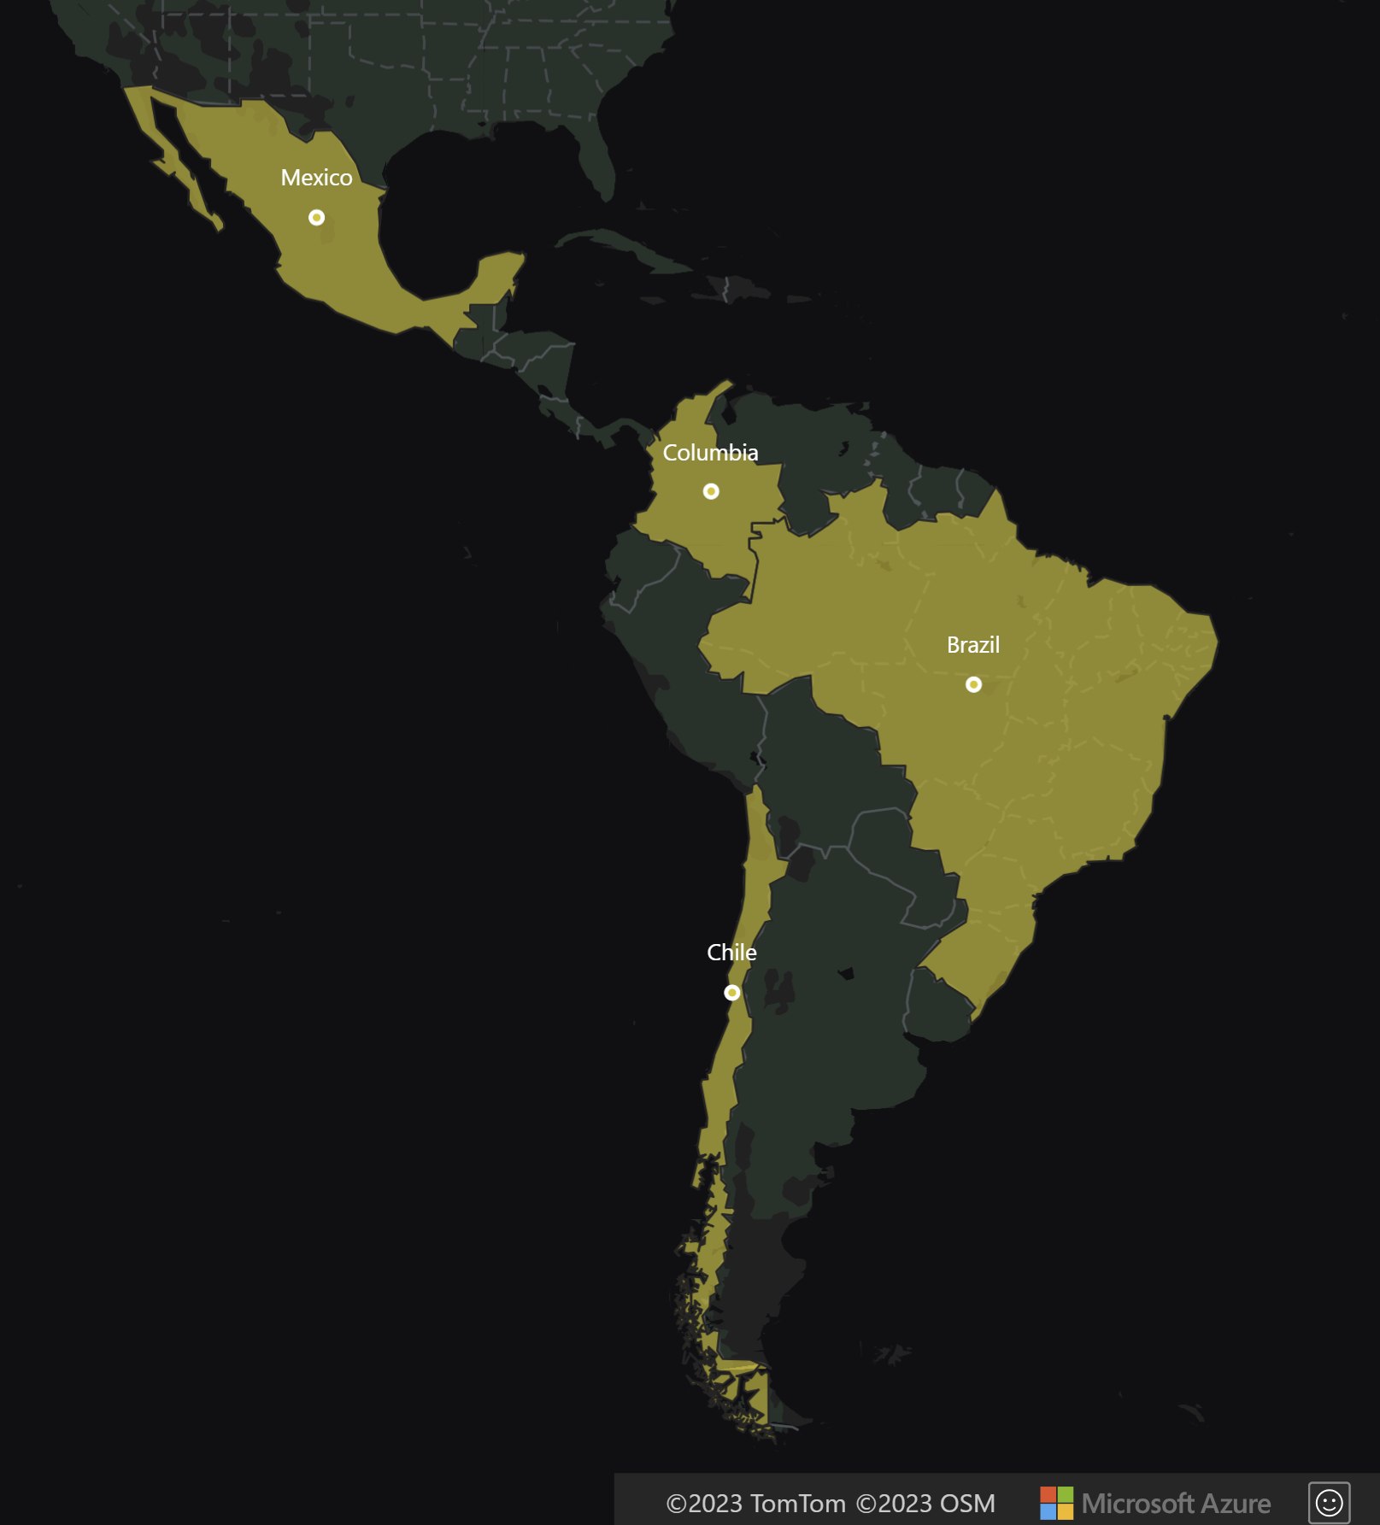
EU
NA
Region & Markets
LAT AM
APAC (Asia Pacific)

Slide 8
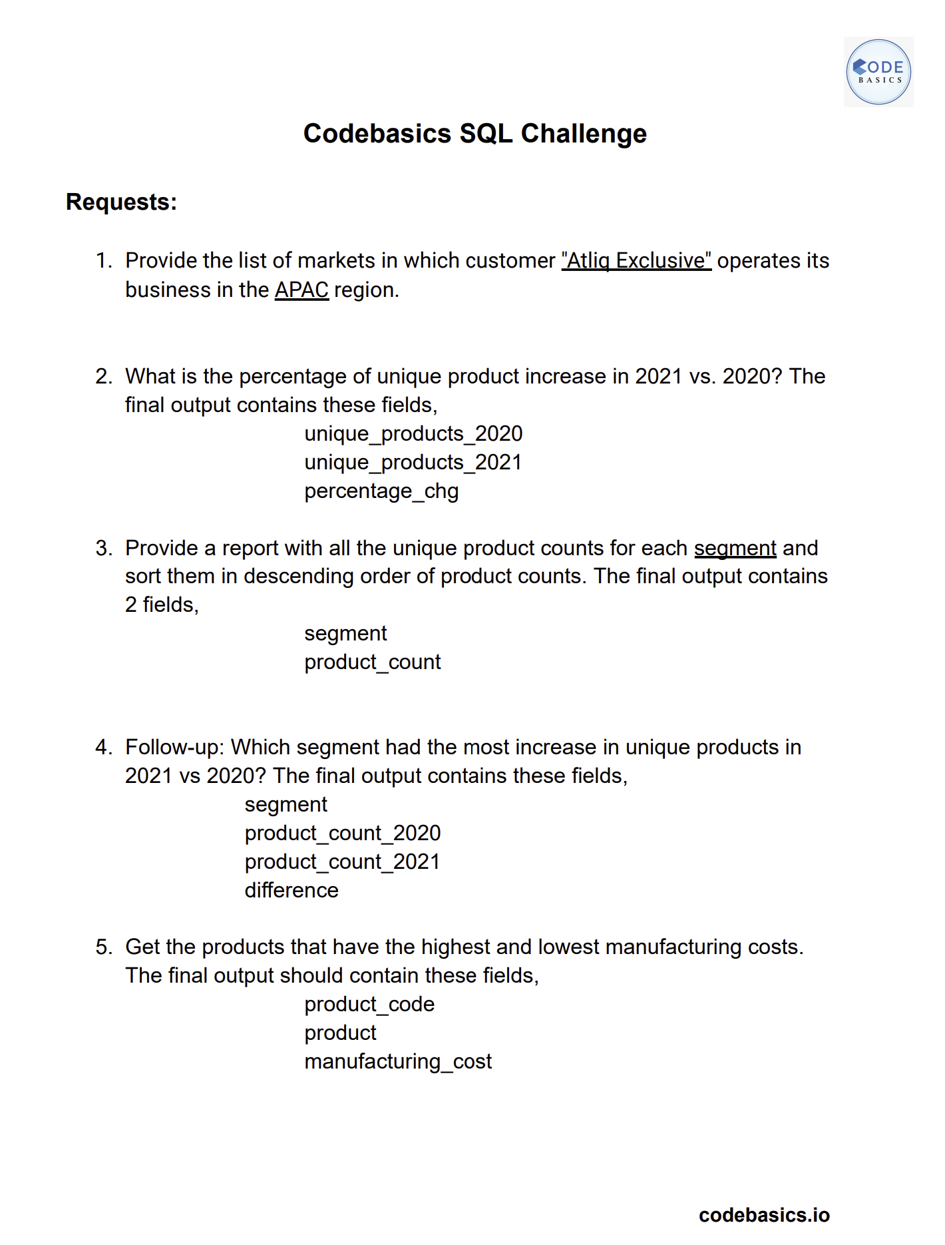
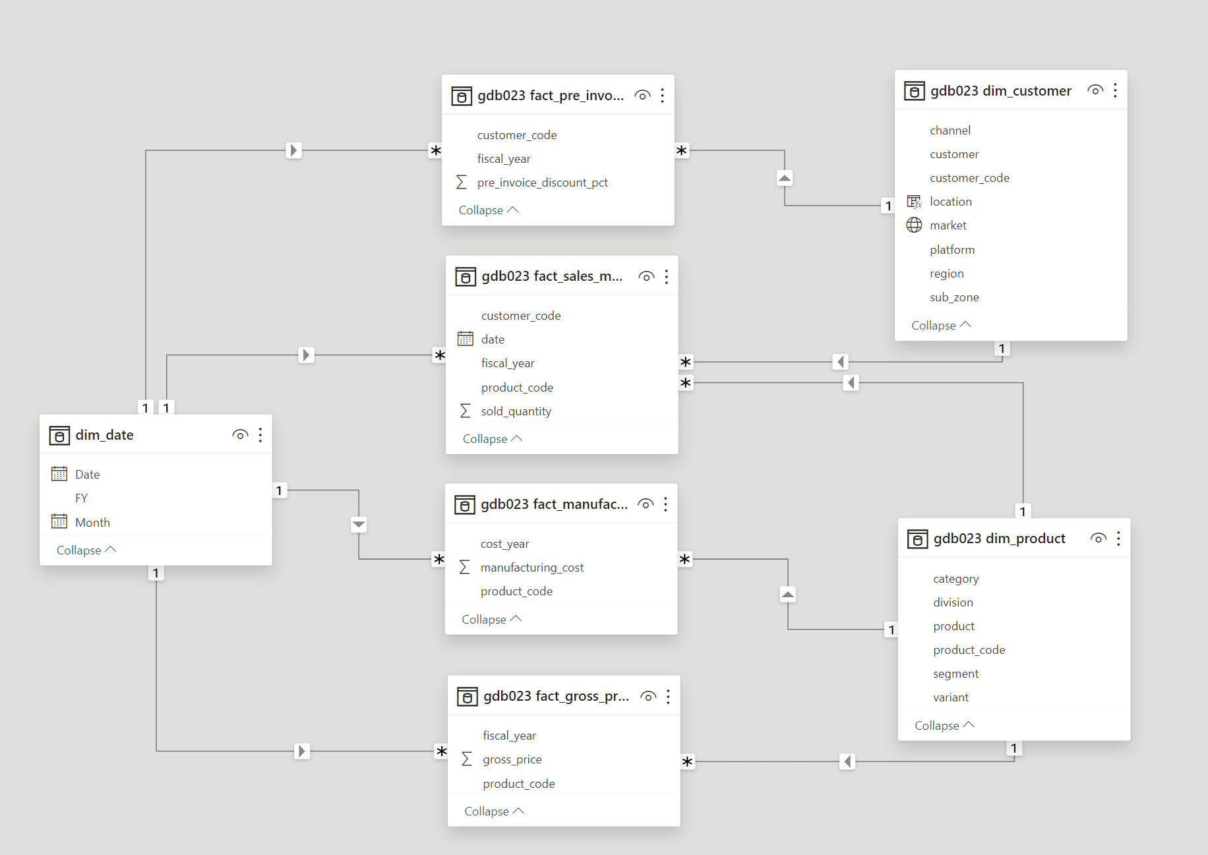
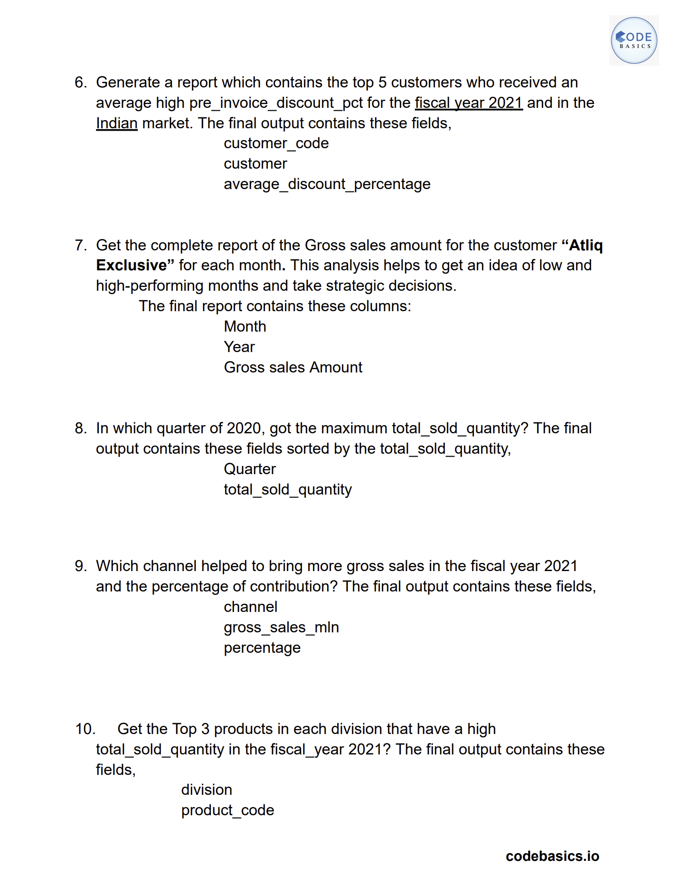

Slide 9
How?
Tools used
mySQL
Power BI
Power Point
Youtube

Slide 10

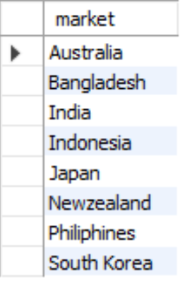
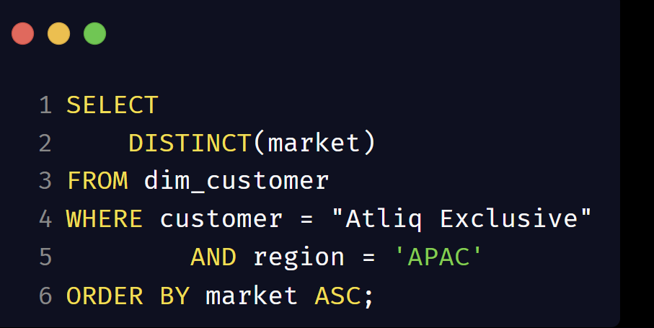
Provide the list of markets in which customer "Atliq Exclusive" operates business in the APAC region.
Explanation:
We select all the distinct market from the customer table.
We use where class to give the condition - customer = "Atliq Exclusive" and region = APAC.
To display the list of countries in alphabetical order, use order market by ascending.

Slide 11
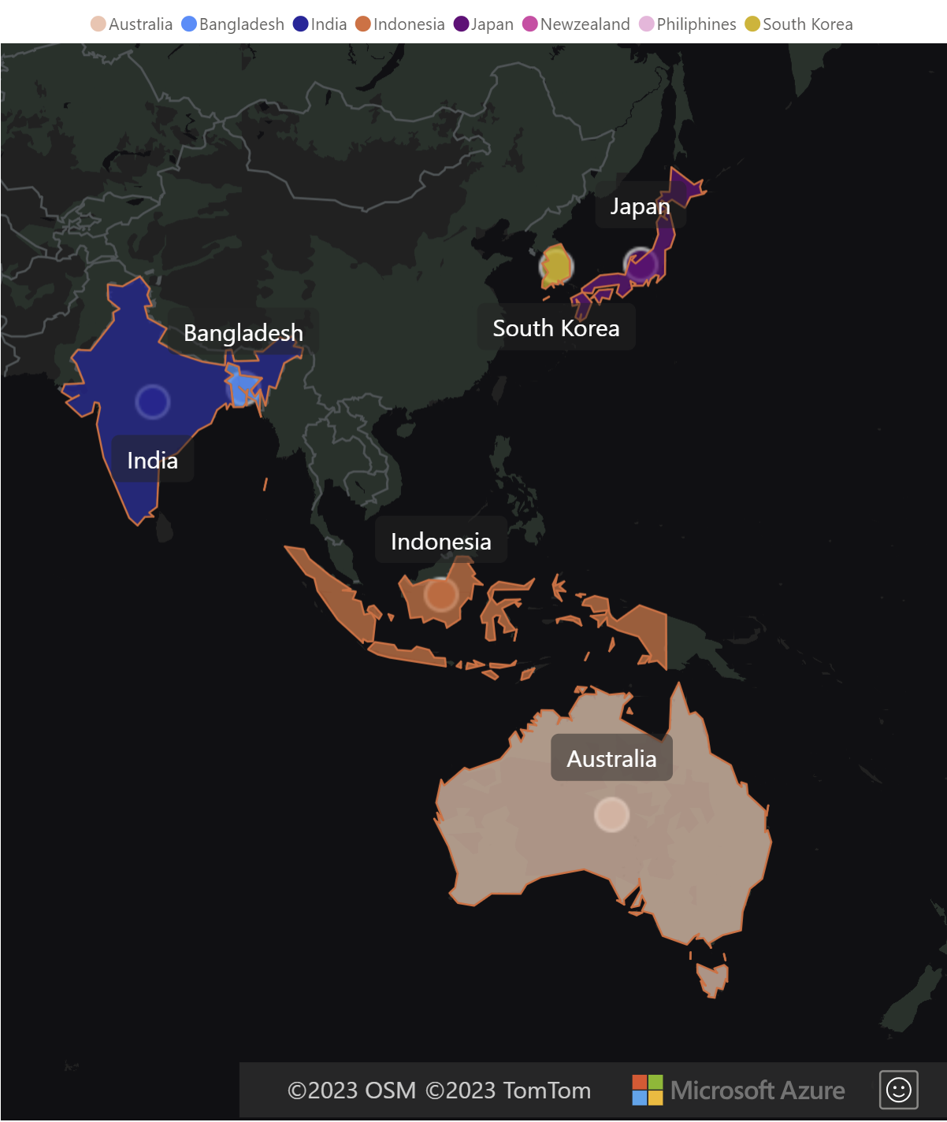
Provide the list of markets in which customer "Atliq Exclusive" operates business in the APAC region.
Insights:
Atliq Exclusive has established its market in 8 countries in the APAC region with ‘India’ being its base market.

Slide 12
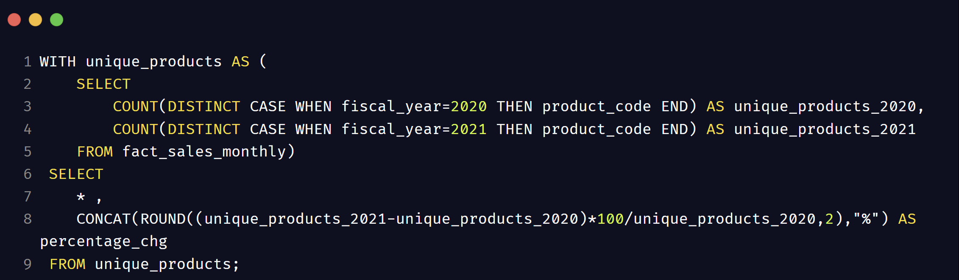
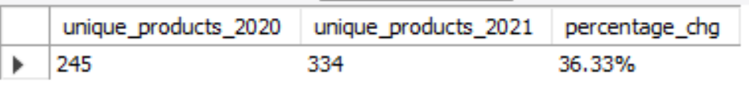
What is the percentage of unique product increase in 2021 vs. 2020? The final output contains these fields : unique_products_2020, unique_products_2021, percentage_chg
Explanation:
From the sales table, we count the number of unique products for the fiscal year 2020 & 2021 separately using Case statements.
With this result stored as a CTE named unique products, we find the percentage of unique products increase from 2020 to 2021.
Round the results to two decimal and concat a percentage symbol for aesthetic reason.

Slide 13
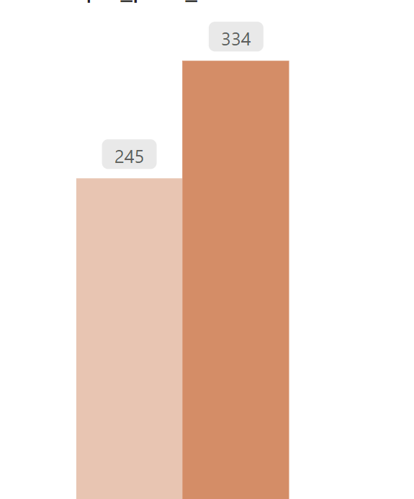
What is the percentage of unique product increase in 2021 vs. 2020? The final output contains these fields : unique_products_2020, unique_products_2021, percentage_chg
36.33%
Insights:
The number of unique products in 2020 was 245 whereas in 2021 it has increased to 334.
we note a 36.33% increase in the number of unique products.
The company has a good growth rate and is capturing new markets.
2020
2021

Slide 14
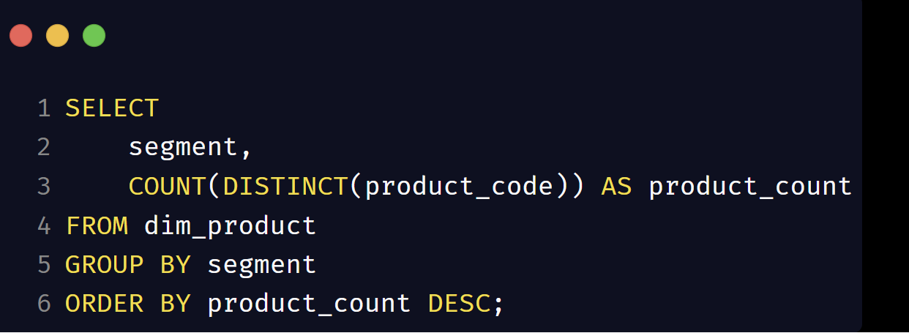
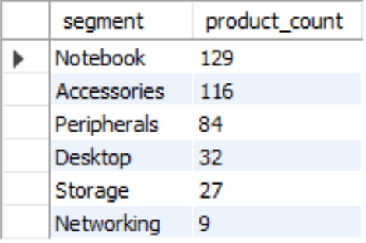
Provide a report with all the unique product counts for each segment. The final output contains 2 fields - segment & product_count. Sort them in descending order of product counts.
Explanation:
From product table, we choose the column segment and count the distinct number of product as product count.
Since we use an aggregate function, we have to use group by.
The final result is ordered by the product count in a descending order

Slide 15
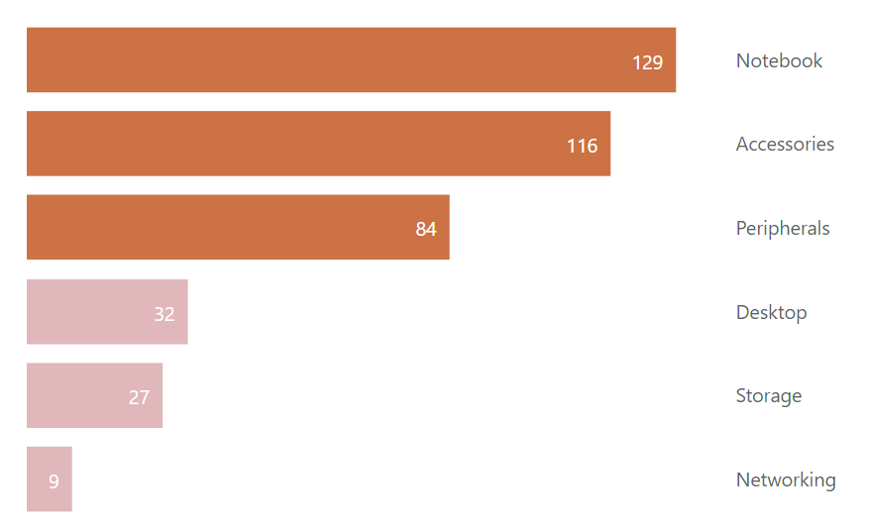
Provide a report with all the unique product counts for each segment. The final output contains 2 fields - segment & product_count. Sort them in descending order of product counts.
Insights:
Notebook, Accessories and peripherals have good and growing number of unique product.
These 3 account for 83% of all unique products.
Desktop, storage and networking needs to concentrate on increasing the number of products offered.

Slide 16
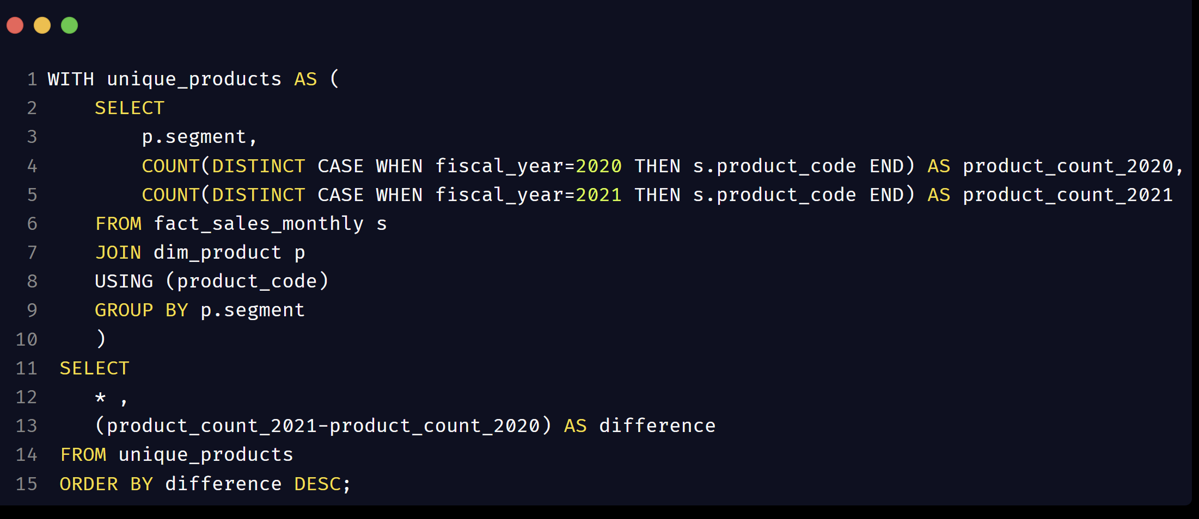
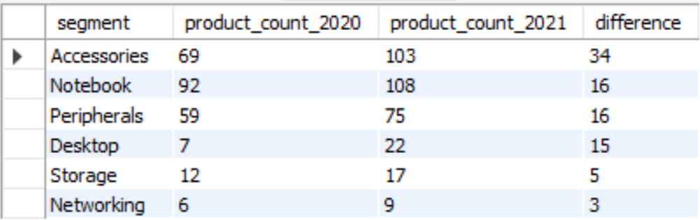
Follow-up: Which segment had the most increase in unique products in 2021 vs 2020? The final output contains these fields:-- segment, product_count_2020, product_count_2021, difference
Explanation:
We find the unique product count for each fiscal year like before using CASE statements.
Group by segment to get the same for each segment.
using the above as a CTE, find the difference in the product count and display the result.

Slide 17
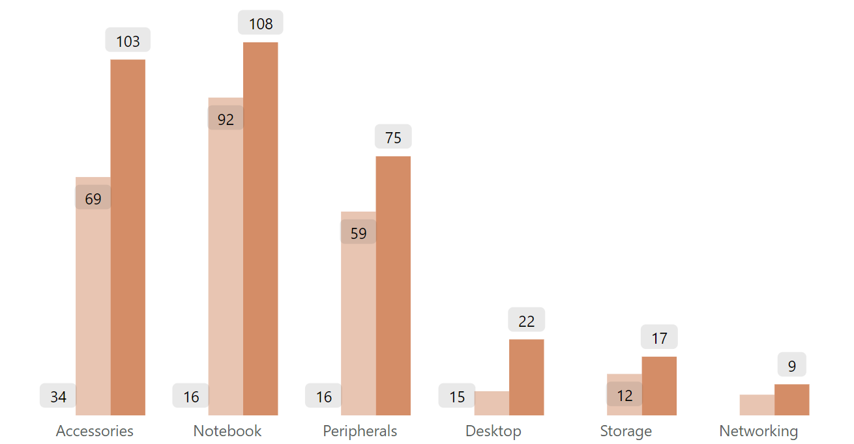
Follow-up: Which segment had the most increase in unique products in 2021 vs 2020? The final output contains these fields:-- segment, product_count_2020, product_count_2021, difference
Insights:
Accessories is the fastest growing segment with increase in unique product count of 34.
Followed by notebook, peripherals and desktop withan increase of 16 each and 15 respectively.
Storage and networking are the least growing segments in terms of increasing the unique product counts.

Slide 18
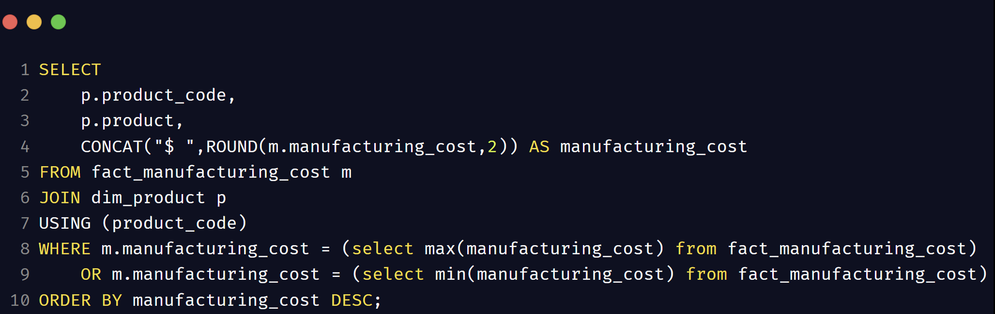


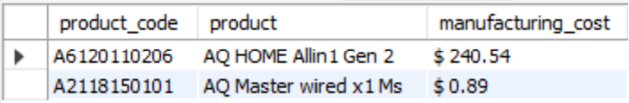
Get the products that have the highest and lowest manufacturing costs. The final output should contain these fields: product_code, product, manufacturing_cost
$240.54
$ 0.89
Explanation:
We join the tables - manufacturing cost and products.
Using separate subqueries to get the maximum and minimum manufacturing cost.
This value is used in where clause to filter the result.

Slide 19
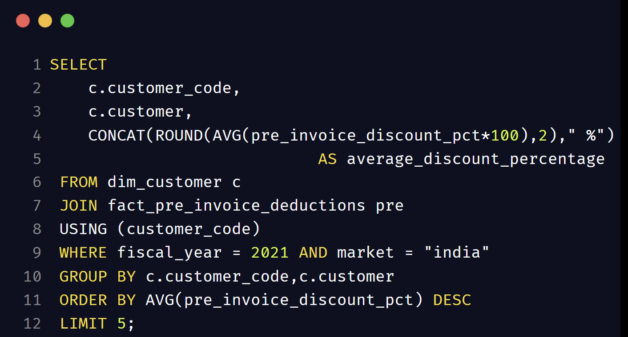
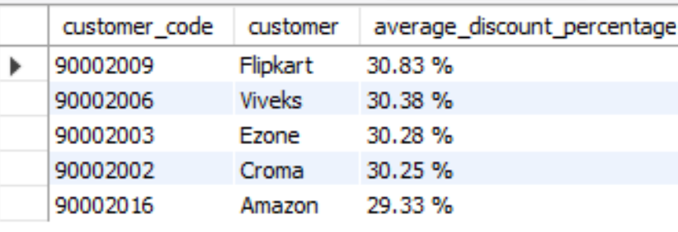
Generate a report which contains the top 5 customers who received an average high pre invoice discount pct for the fiscal year 2021 in the Indian market. The final output contains these fields: customer_code, customer, average_discount_percentage
Explanation:
We join the required tables and give filter conditions in where clause.
Since we need to calculate an aggregate fn, use group by.
To get the top 5, order by descending and limit the results to 5 rows.

Slide 20
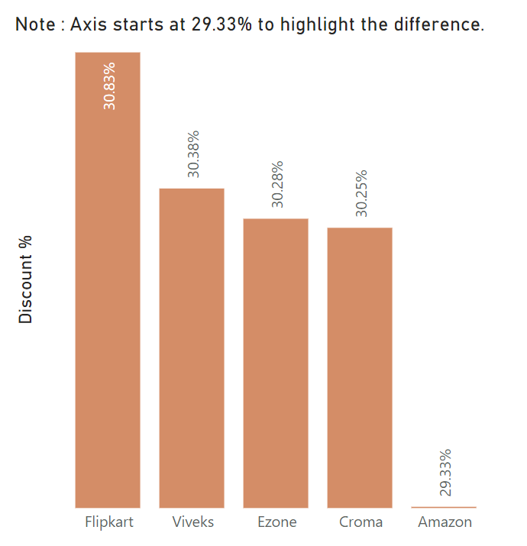
Generate a report which contains the top 5 customers who received an average high pre invoice discount pct for the fiscal year 2021 in the Indian market. The final output contains these fields: customer_code, customer, average_discount_percentage
Insights :
5 customers get an approximately the same range of discount percentage.
This is not ideal but just to study the difference even further I have chosen to start the axis of the bar chart at 29.33 percentage
We can note that Flipkart has maximum discount percentage of 30.83.
Viveks, Ezone and chroma have almost the same % of about 30.3
Amazon has the lowest among the top five with 29.33% discount.

Slide 21
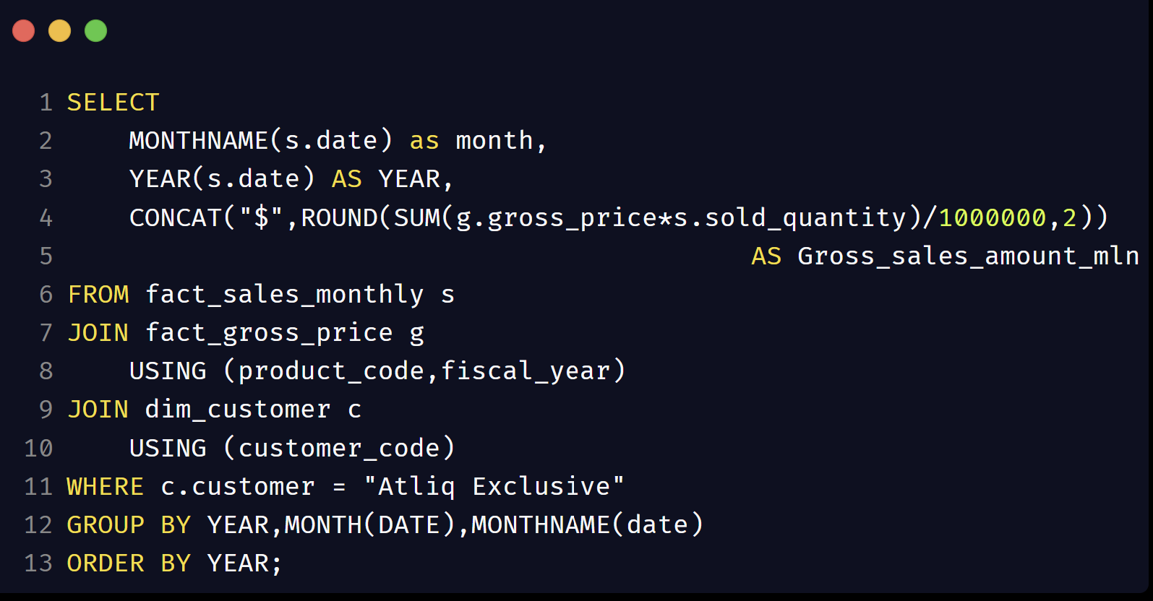
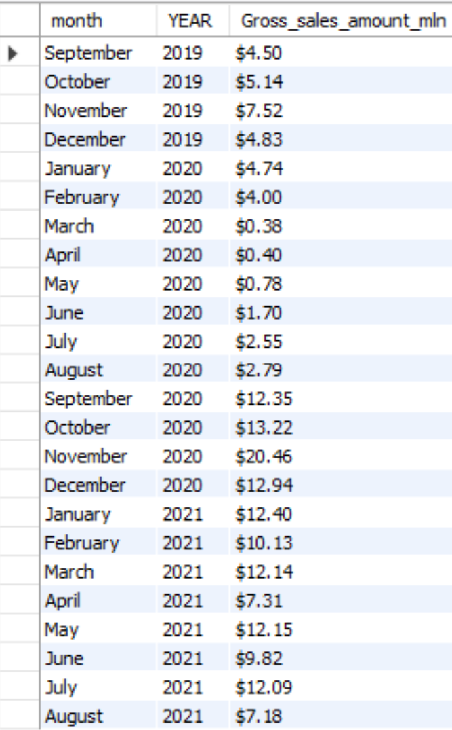
Get the complete report of Gross sales amount for “Atliq Exclusive” for each month. This analysis helps to get an idea of low and high-performing months and take strategic decisions. The final report contains these columns: Month, Year, Gross sales Amount
Explanation:
Gross sales amount is obtained using gross price and sold quantity. To filter the data for the given customer, I am using customer also.
We need to perform multiple joins.
Since we are asked to generate report with data for each month, we use the time function, month name to get month from the date.
I want to display the final report in the time sequence, so I have also taken the year from the date.

Slide 22
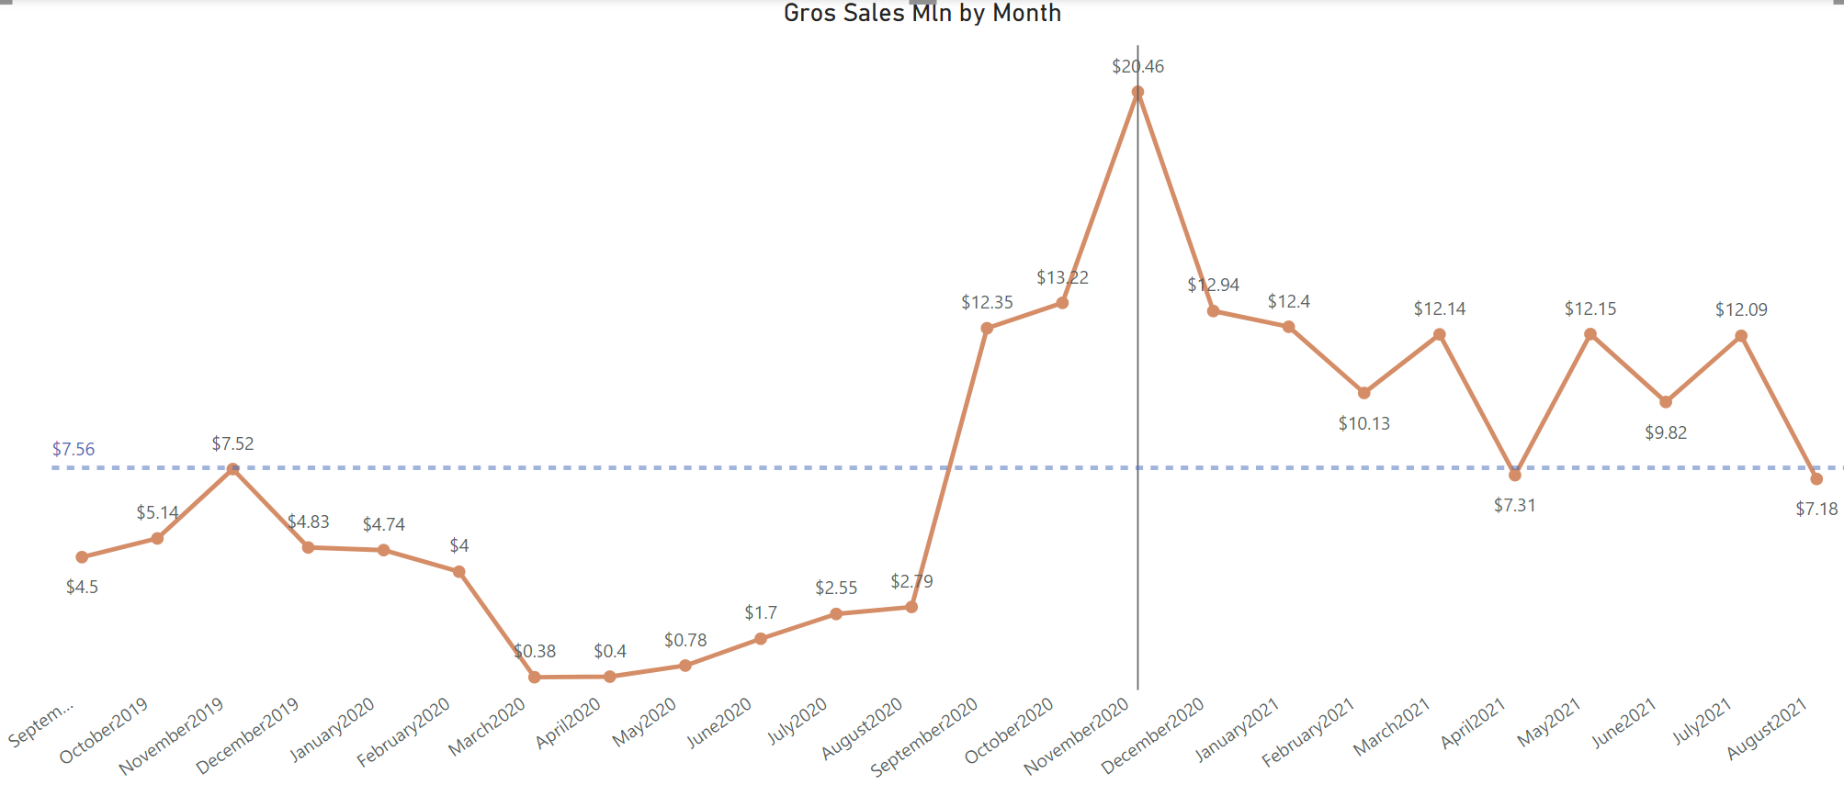
Get the complete report of Gross sales amount for “Atliq Exclusive” for each month. This analysis helps to get an idea of low and high-performing months and take strategic decisions. The final report contains these columns: Month, Year, Gross sales Amount
Insights:
The trend of gross sales amount over the months can be classified into two distinct parts:
Sales data from fiscal year 2020 where it is below the average line,
the part where it is mostly above the average line for the fiscal year 2021.
The minimum value is seen in March 2020 can be attributed to the COVID and it remains there because there was not much sales made during this period.
From September, we can see a drastic increase in the gross sales, and we can see the peak in November 2020. This can be attributed to the holiday season right after COVID when people started purchasing. The company has maintained their gross sales above the average line after picking back up.

Slide 23
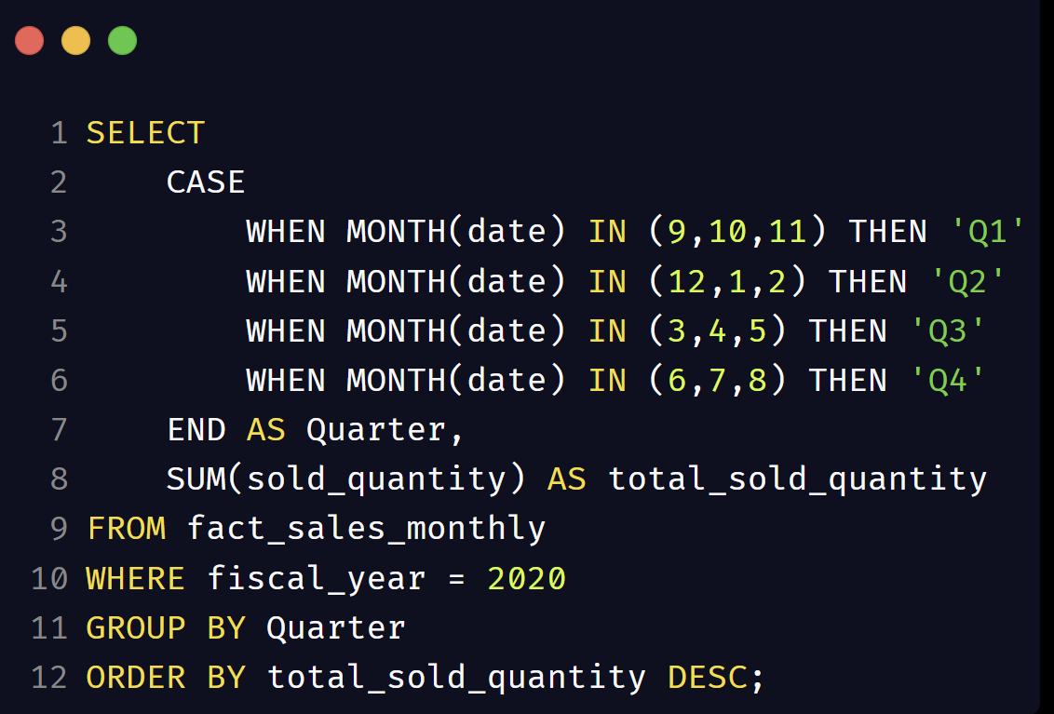
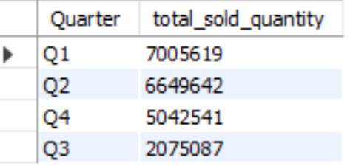
In which quarter of 2020, got the maximum total_sold_quantity? The final output contains these fields: sorted by the total_sold_quantity, Quarter, total_sold_quantity.
Quarter | Calendar Months
Q1 2020 | Sept, Oct, Nov 2019
Q2 2020 | Dec2019, Jan, Feb 2020
Q3 2020 | Mar, Apr, May 2020
Q4 2020 | Jun, Jul, Aug 2020
Explanation:
Since the fiscal year for Atliq starts in September, we cannot use the built in QUARTER function from SQL.
I'm getting the month number from date and comparing it to numbers (9,10 or11). If it matches, then it is Q1 when it is in (12,1 or2) then it is Q2 and so on.
Using case statement and above logic, we get quarter.
We filter out the values based on fiscal year 2020.

Slide 24
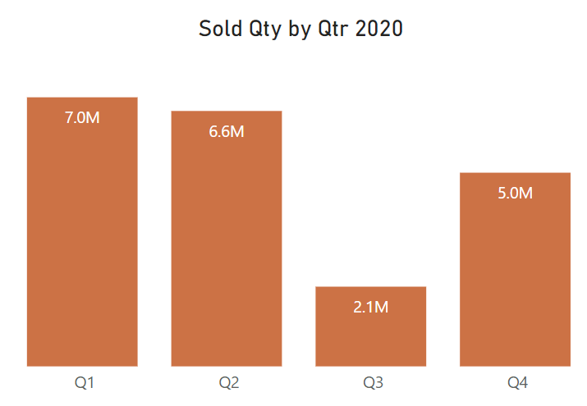
In which quarter of 2020, got the maximum total_sold_quantity? The final output contains these fields: sorted by the total_sold_quantity, Quarter, total_sold_quantity.
Insights:
The fiscal year of Atliq starts from September.
I have given a table showing the quarter with the corresponding months. As you can see the Q3 corresponds to March April and May of 2020 which is when COVID started spreading for most of the world.
We can see from the graph the direct result of that. Q3 sales is at the minimum with 2.1 million quantities sold.
We can also see the Q4 sales have improved 5 million which is a good thing that our company bounced back quickly from the effect of COVID.
Quarter | Calendar Months
Q1 2020 | Sept, Oct, Nov 2019
Q2 2020 | Dec2019, Jan, Feb 2020
Q3 2020 | Mar, Apr, May 2020
Q4 2020 | Jun, Jul, Aug 2020

Slide 25
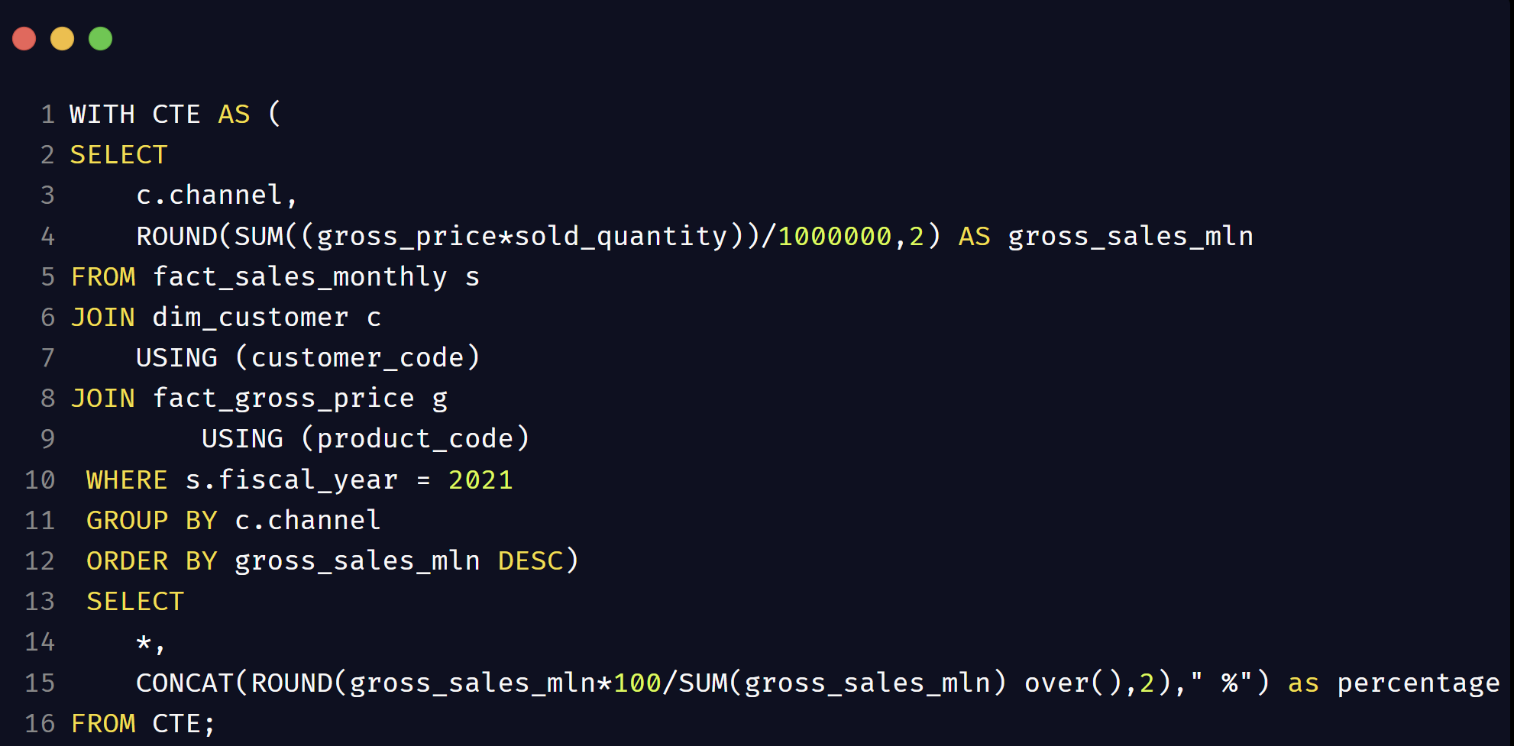
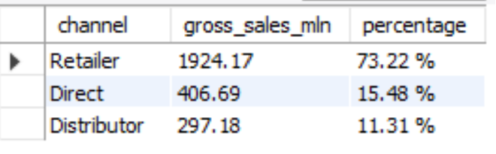
Which channel helped to bring more gross sales in the fiscal year 2021 and the percentage of contribution? The final output contains these fields: channel, gross_sales_mln, percentage
Explanation:
We compute the gross sales from gross price and sold quantity of the records from 2021, group it by channel to get gross sales million per channel for the fiscal year 2021.
The obtained result is stored in a CTE.
To find the percentage contribution of each channel we have to use window function over() on the gross sales million obtained in the above CTE.

Slide 26
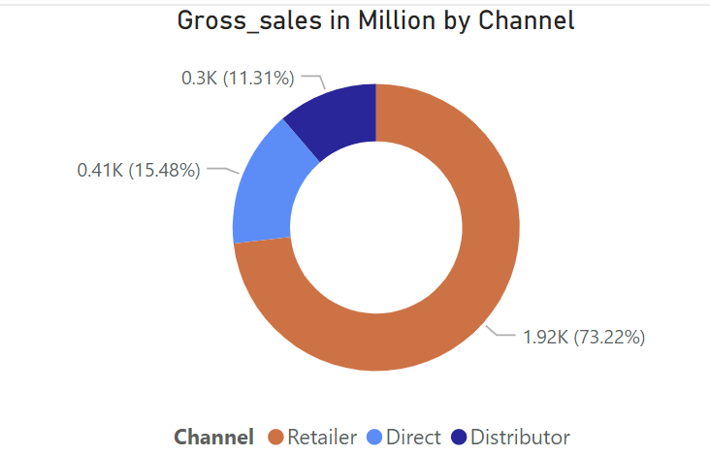
Which channel helped to bring more gross sales in the fiscal year 2021 and the percentage of contribution? The final output contains these fields: channel, gross_sales_mln, percentage
Insights:
we have only three channels in our data. To represent the percentage contribution of each channel for the given year, I chose to use the donut chart.
We can see that a retailer has been our major part major source of sales accounting almost 75%.
The other channels, direct and distributor have a similar market share with 15.5% and 11.5% respectively.

Slide 27
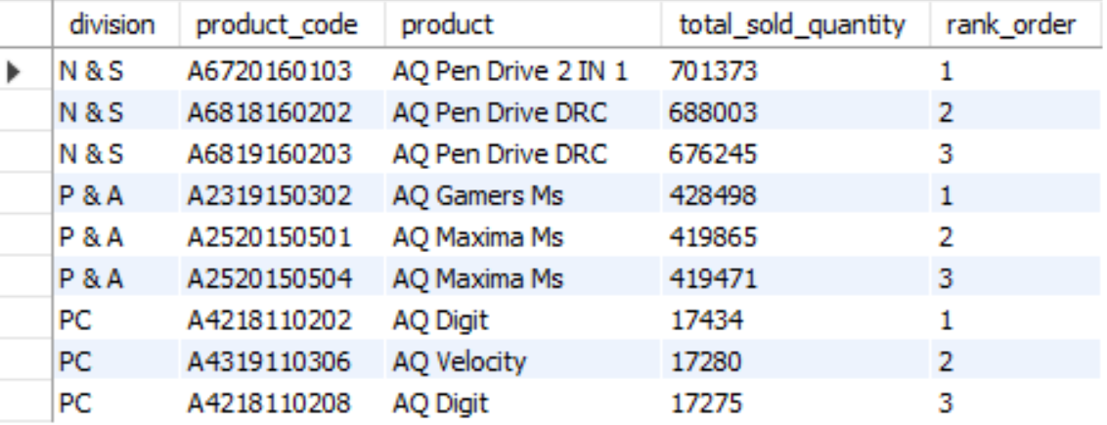
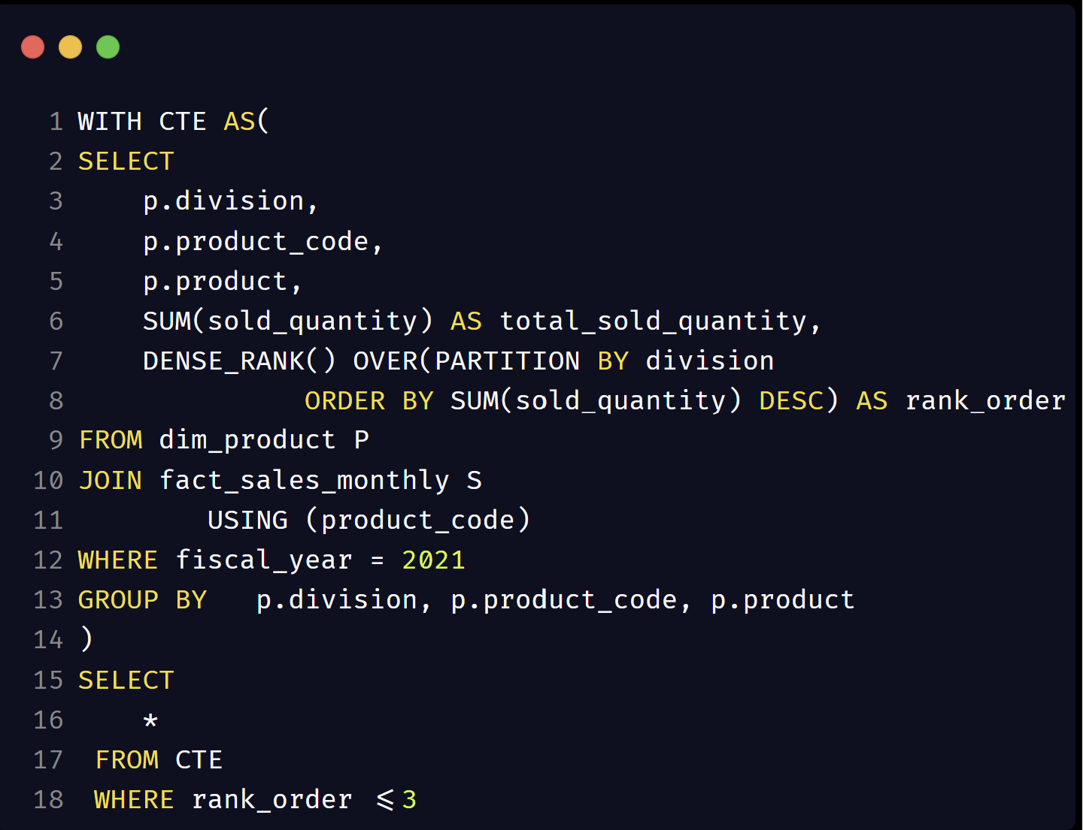
Get the Top 3 products in each division that have a high sold quantity in the fiscal year 2021? The final output contains these fields: division, product_code, product, total_sold_quantity, rank_order
Explanation:
Calculate the total sold quantity for the fiscal year 2021 per product.
To find the top three products for each division, we give this result a rank using window function, DENSE_RANK where it is partitioned by division and ordered by sold quantity.
Store the above result in a CTE.
We get the final result where I filter the rank to display only those values where the rank order<=3.

Slide 28
Thank You
Mythily Ramanathan

Slide 29
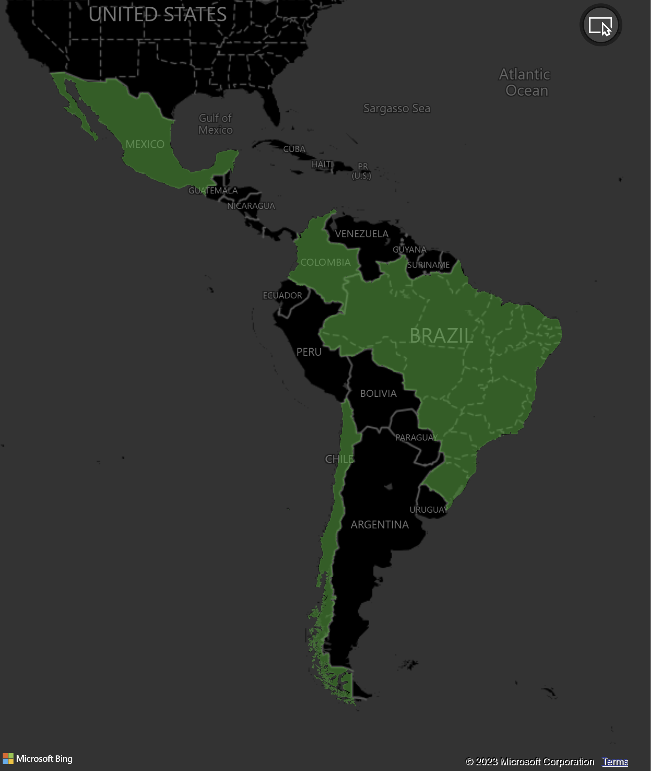
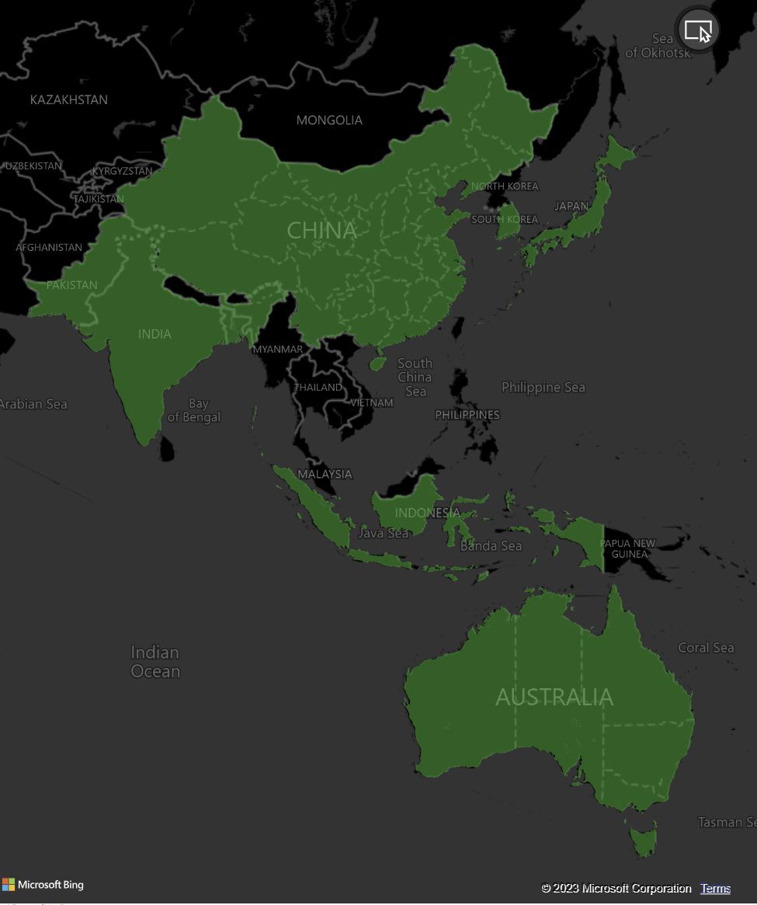
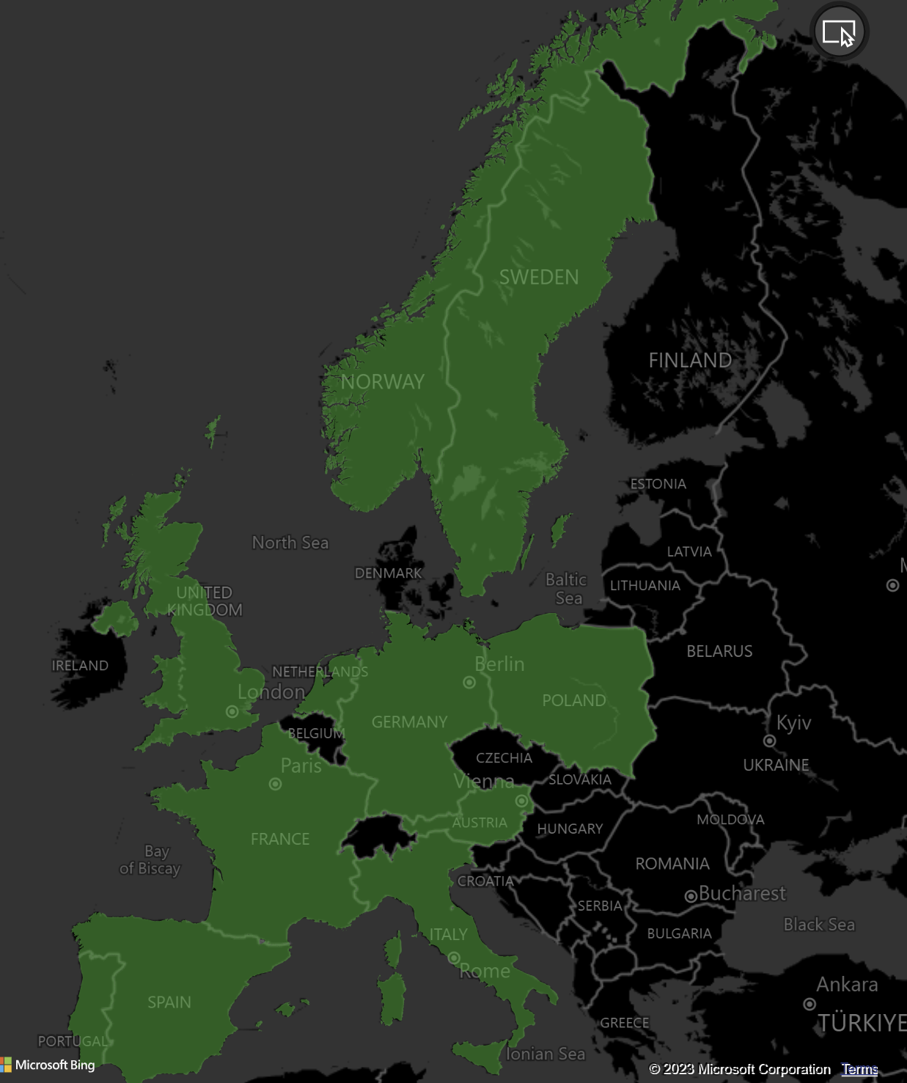

Slide 30
